Slide 1
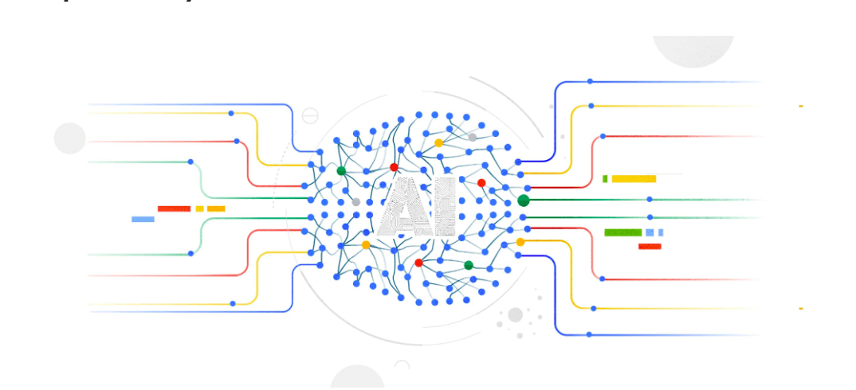

Google Cloud AI
Drashti Patel | 0768659

Slide 2
What is google cloud ai?
Google Cloud AI is a suite of tools and APIs provided by Google Cloud Platform for building and deploying machine learning models on Google's infrastructure.
It includes pre-trained models for various applications, as well as tools for data preparation, training, and deployment of custom models.
This makes it easy for businesses and developers to integrate machine learning into their applications without requiring extensive knowledge of the field.

Slide 3
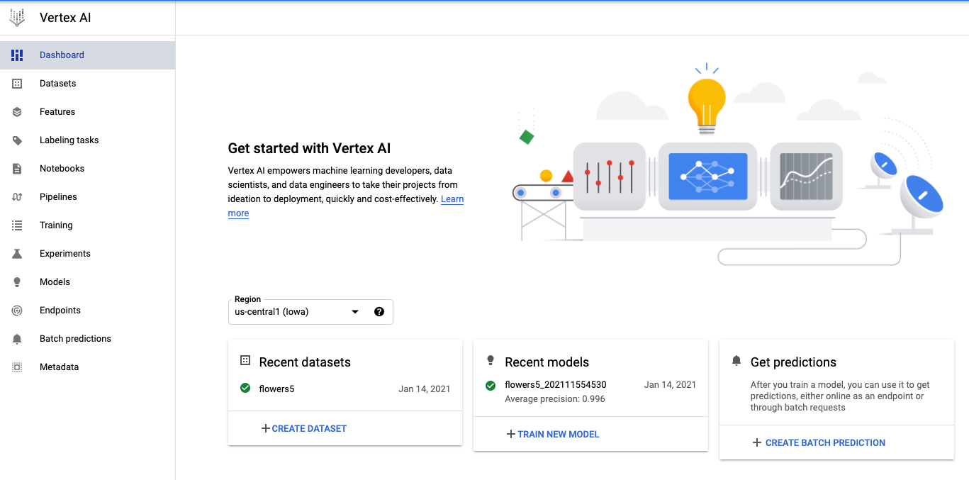
Cloud Computing AI Platform-Dashboard

Slide 4
Learning Goals
Learn how to use AutoML tools to train a model on a dataset using Google Cloud AI Platform.
Understanding how to test the trained model to guarantee accuracy and effectiveness.
Learn how to deploy the Trained model on the Google Cloud AI Platform.
Using essential aspects such as accuracy, performance, scalability, and ease of use to assess the success of a project on Google Cloud AI Platform.

Slide 5
Methodology
Create Dataset, such as Tabular dataset, and image dataset or natural language processing.
Train the model on a dataset.
Evaluate the trained model to ensure it is accurate and effective.
Deploy the trained model on Google Cloud AI Platform.
Test the results of the project, considering factors such as accuracy, performance, scalability, and ease of use.

Slide 6
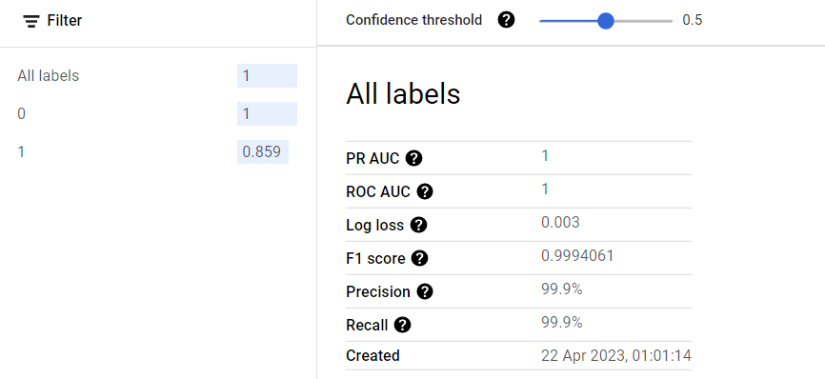
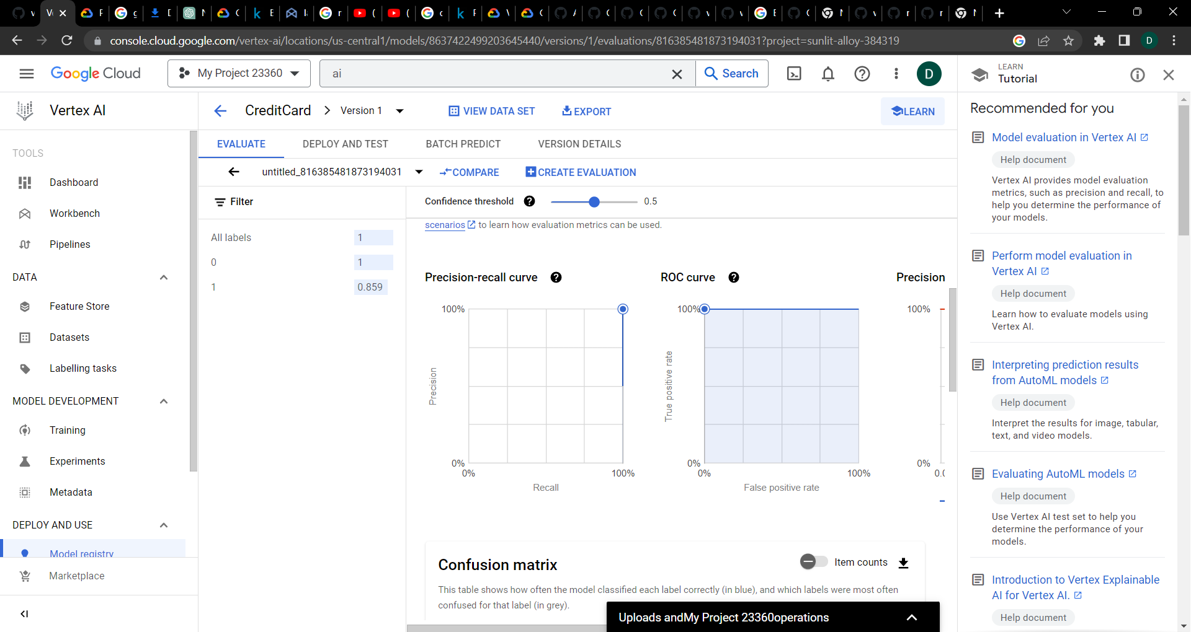
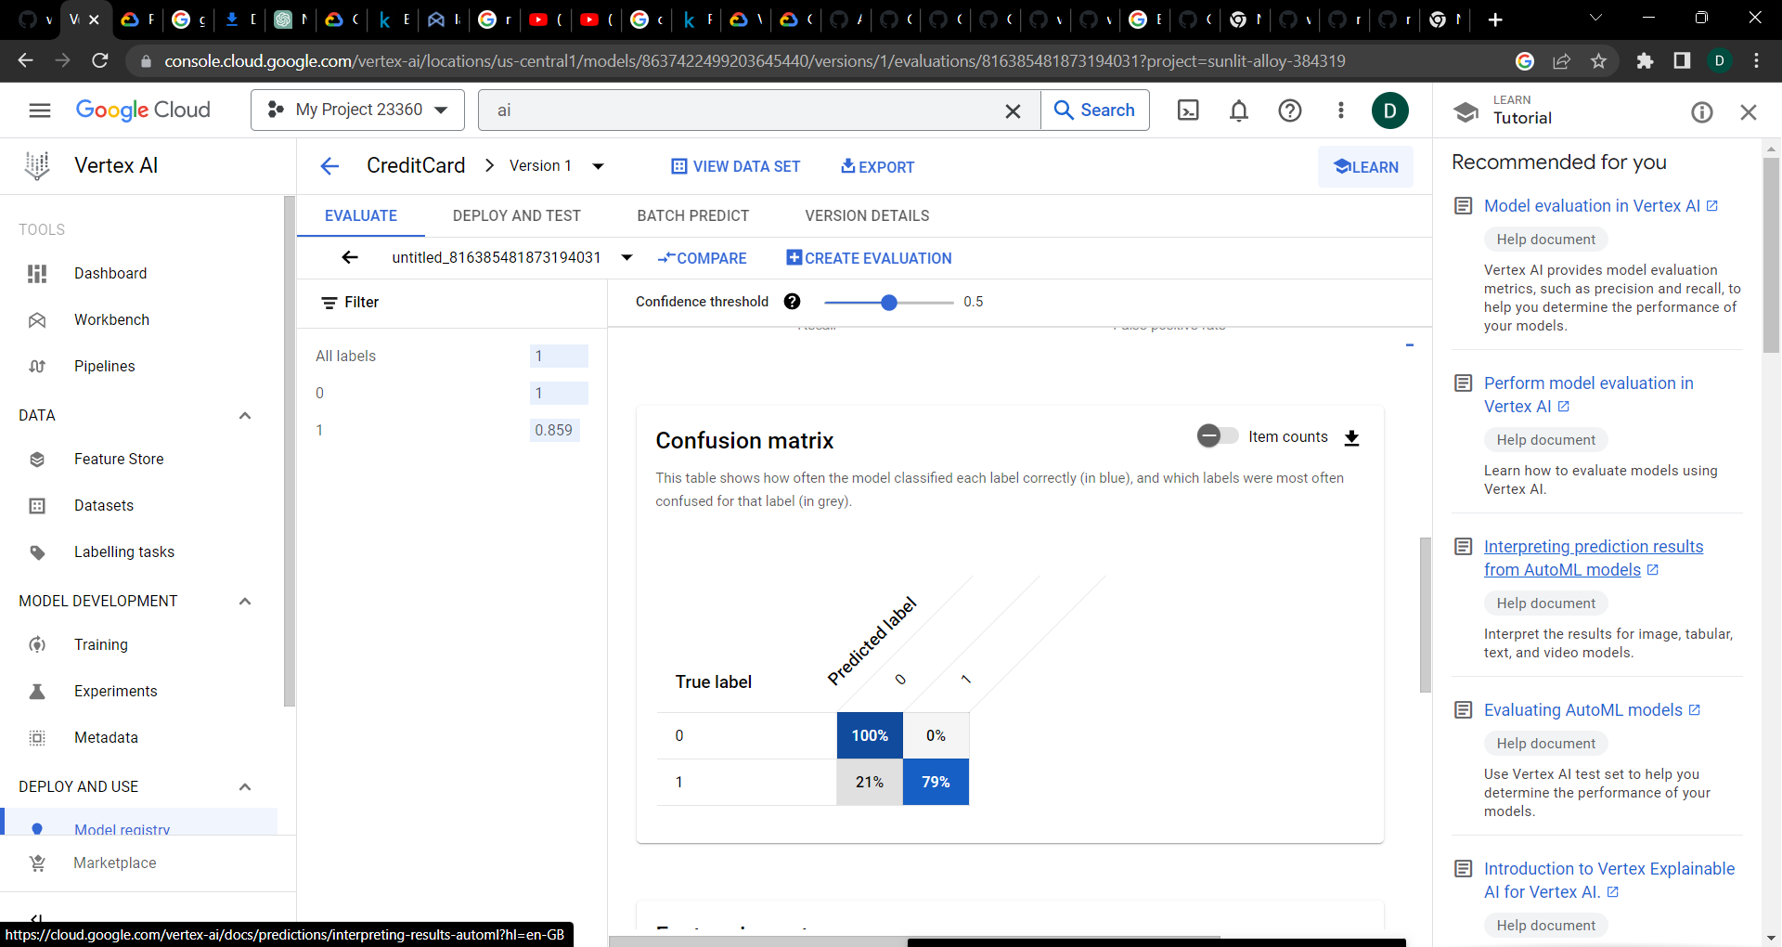
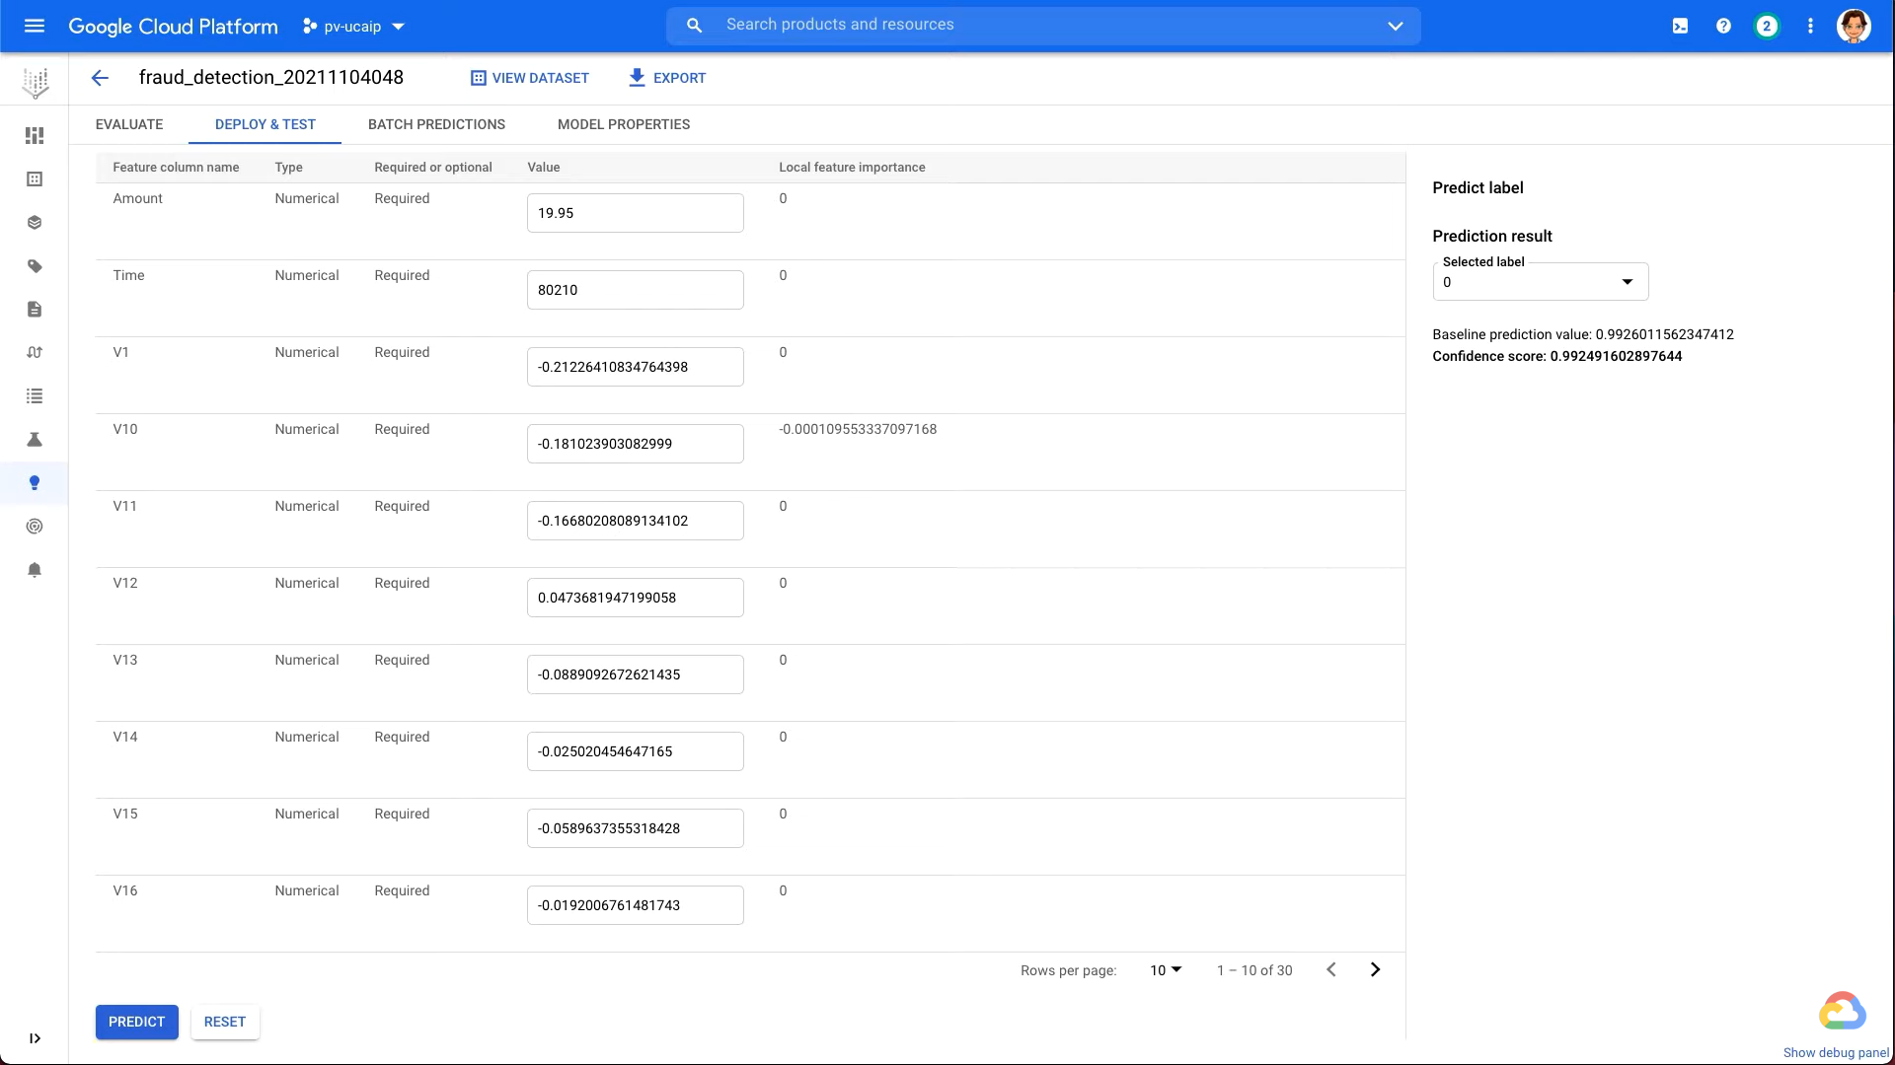
Results-Tabular dataset

Slide 7
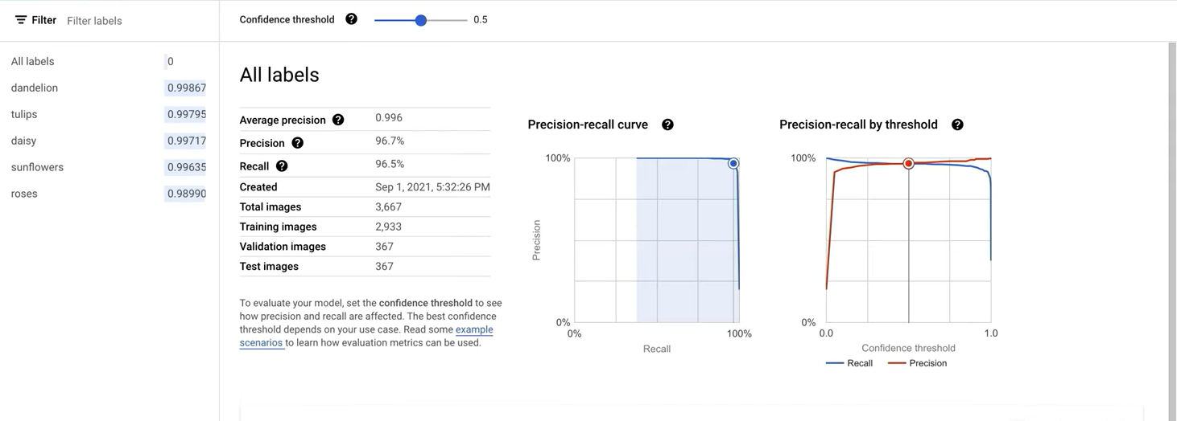
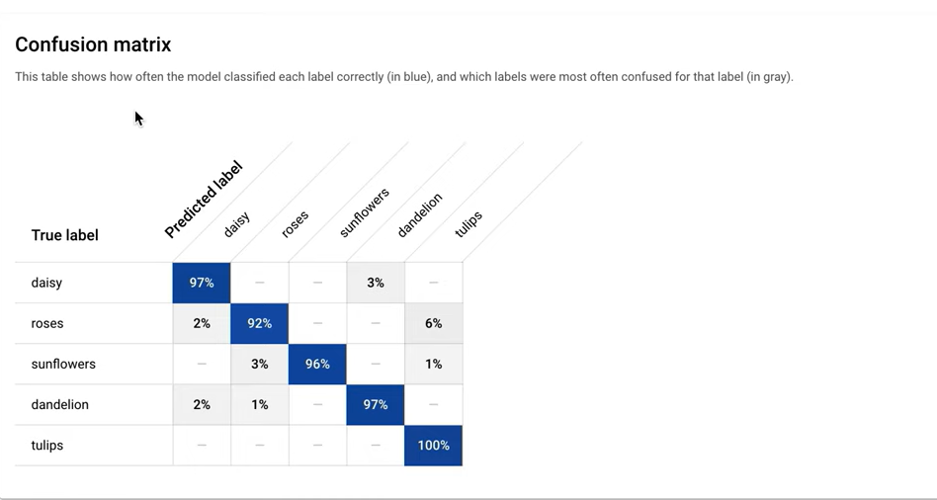
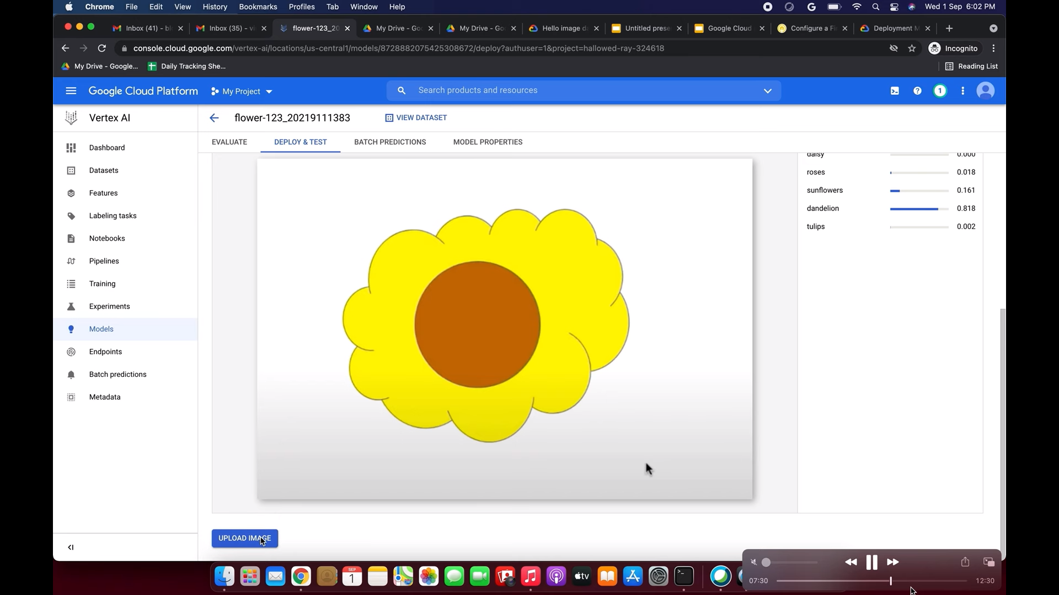
Results-Image dataset

Slide 8
Conclusion
In summary, the goal is to learn about Google Cloud AI Platform, AutoML, and working with different datasets, such as a tabular dataset for credit card fraud detection and an image dataset for flower recognition. Google Cloud AI Platform is a powerful tool for building and deploying machine learning models, regardless of the type of dataset. With its AutoML tools and pre-built models, it simplifies and streamlines the process of building and testing machine learning models, while the Vertex AI Dashboard makes it easy to manage and monitor them. Its scalability and ease of use make it a popular choice for businesses and individuals looking to build effective machine learning models quickly and efficiently.
Video Link - https://youtu.be/l4AYcFuFeGo

